Slide 1
Reinforcement Learning for Vehicle Routing Problem
Rotem Bar
Uria Levkovitz

Slide 2
Table of Contents
Introduction – Problem Definition
Previous Traditional Algorithms
Reinforcement Learning for the VRP
Experiments Results

Slide 3
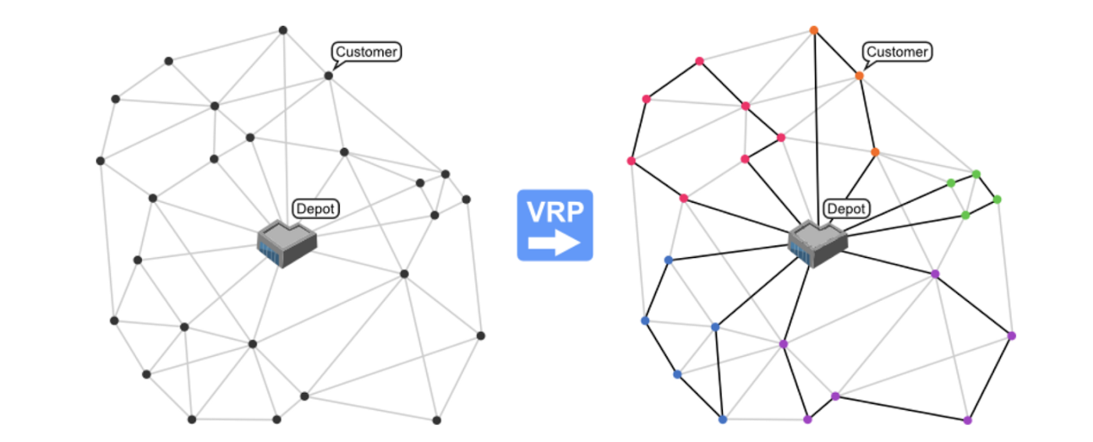
Vehicle Routing Problem
What should we ship?
How should we ship?, i.e. what combination of vehicles should we choose to deliver material?
Who should we ship with? Which transporter shall we choose for each truck?
Which location’s materials can be clubbed in the same truck?
The goal is to minimize the overall cost that the company would end up paying to the transporters.

Slide 4
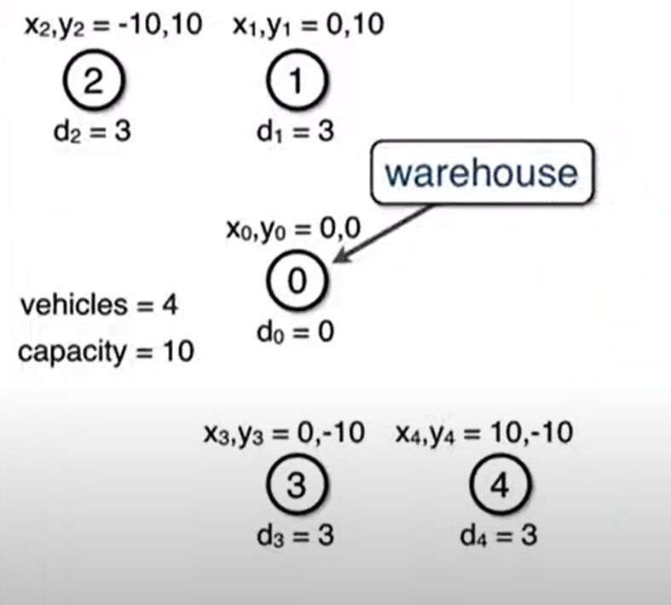
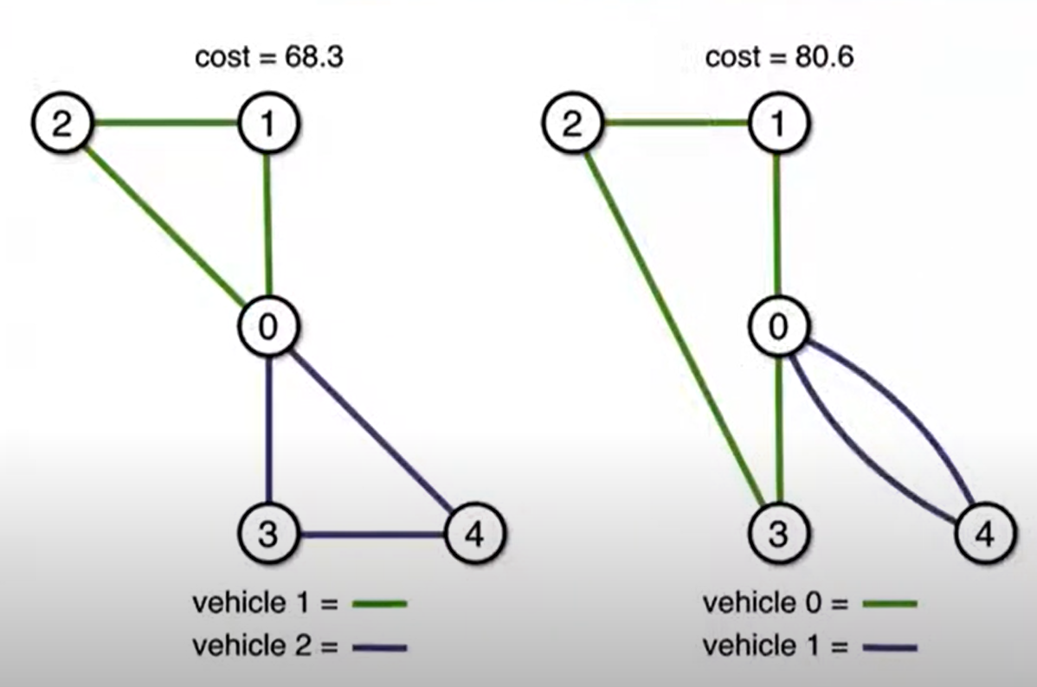
VRP- Example
Problem
Bad Solution
Good Solution

Slide 5
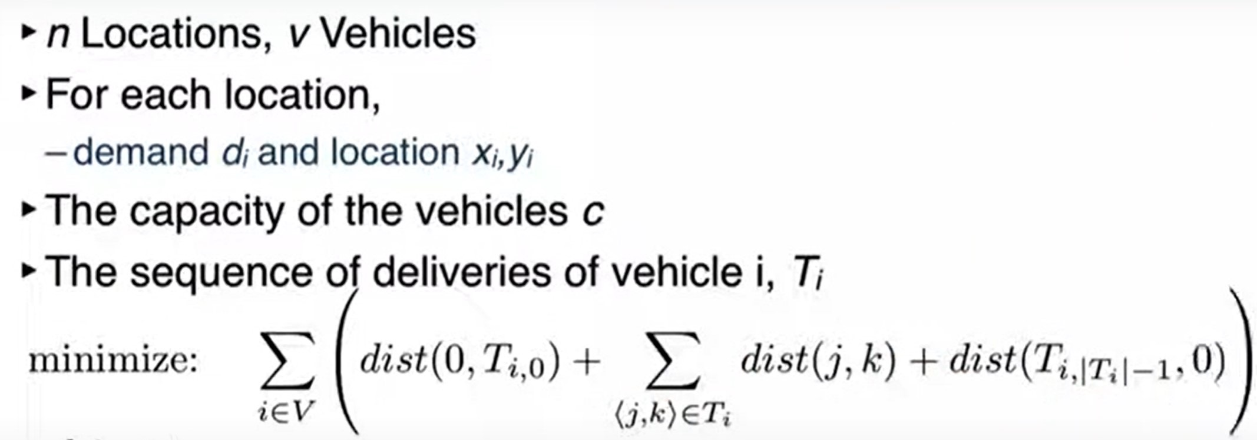
VRP- Goal
Inputs: Vectors of the costumer’s coordination and their demands while for the warehouse the coordinates are (0,0,0).
Outputs: Vectors of the vehicales sequence

Slide 6
Computational Complexity of VRP
Every computational problem can be categorized based on its inherent difficulty as mentioned below.
Complexity Class P: Problems can be solved in polynomial time.
Complexity Class NP: Problems that cannot be solved in polynomial time, but once solved, their solution can be verified in polynomial time.
Complexity Class NP-Hard: Problems that can neither be solved nor their solution can be verified in polynomial time.

Slide 7
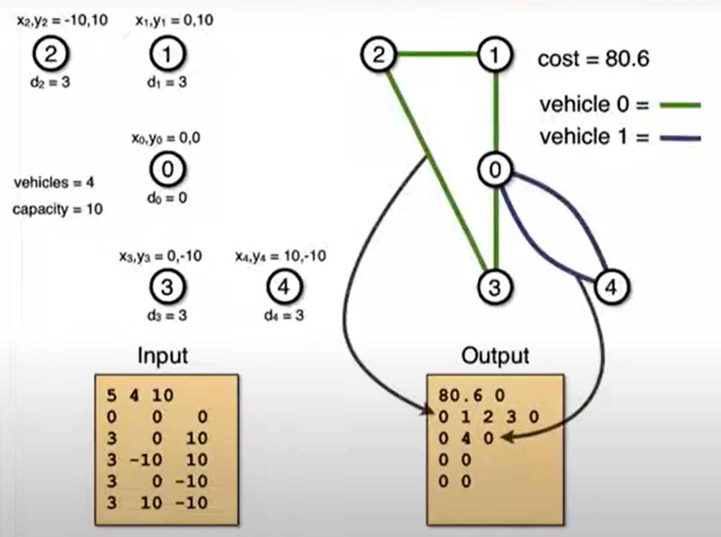
VRP

Slide 8
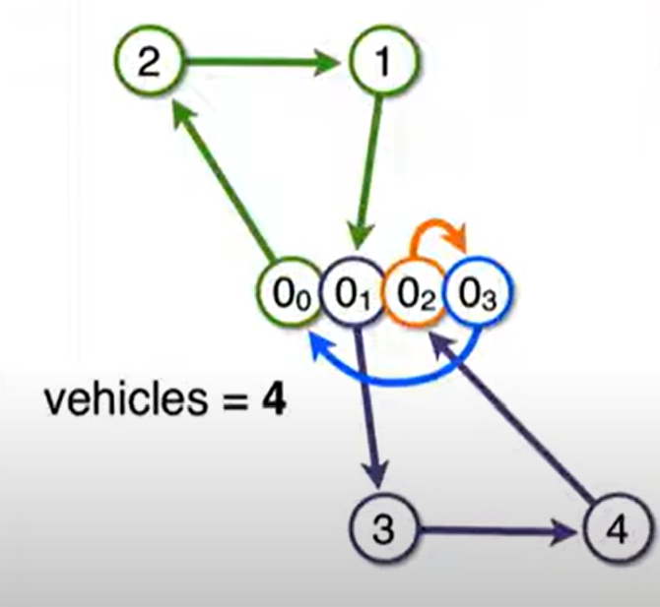
VRP – Circuit Constrain (CP)

Slide 9
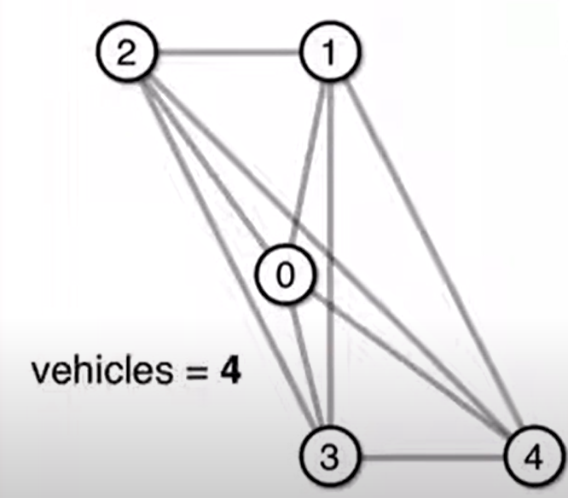
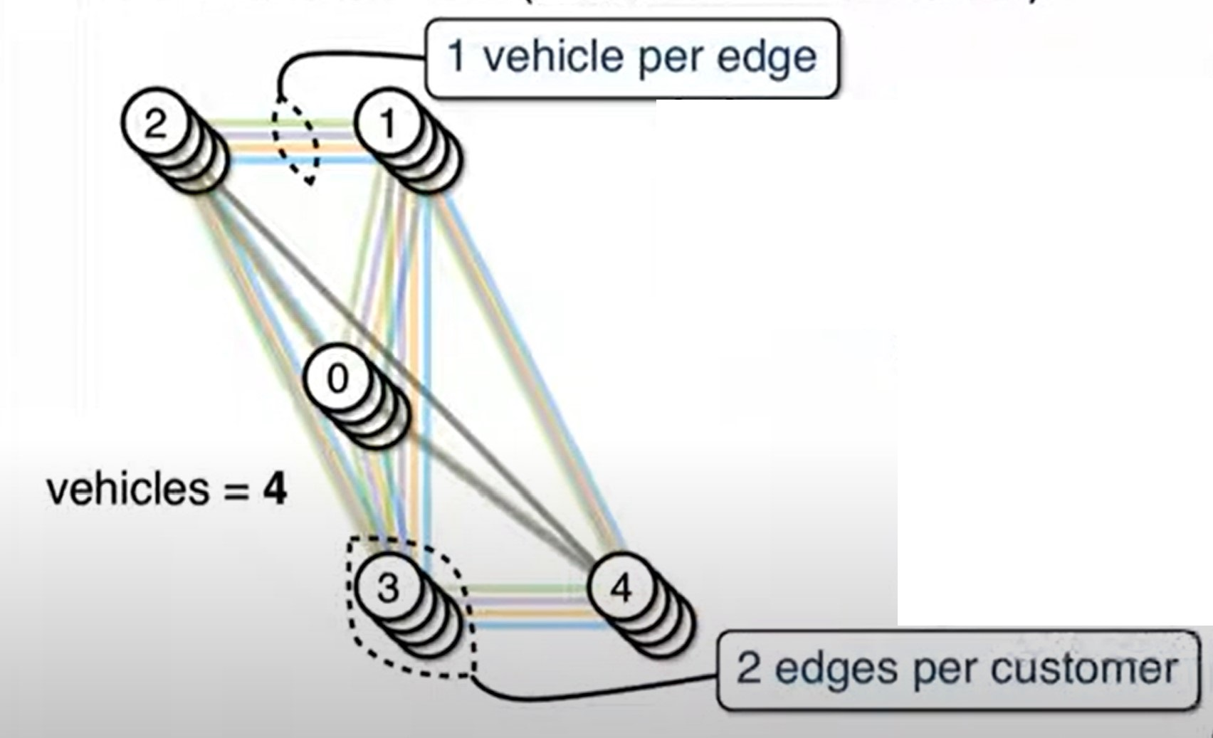
VRP – Mixed Integer Programming (MIP)

Slide 10
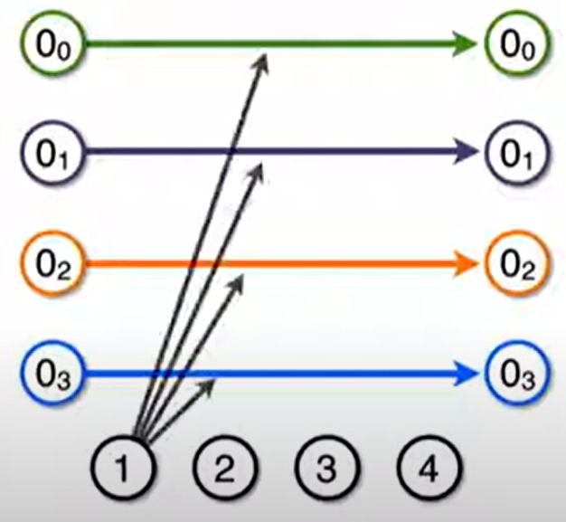
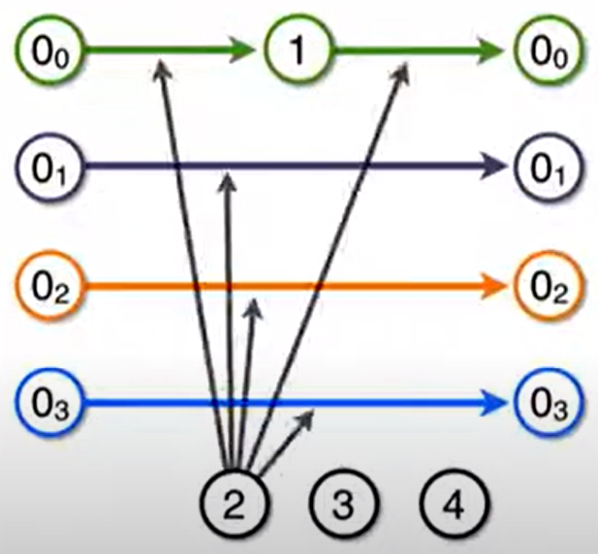
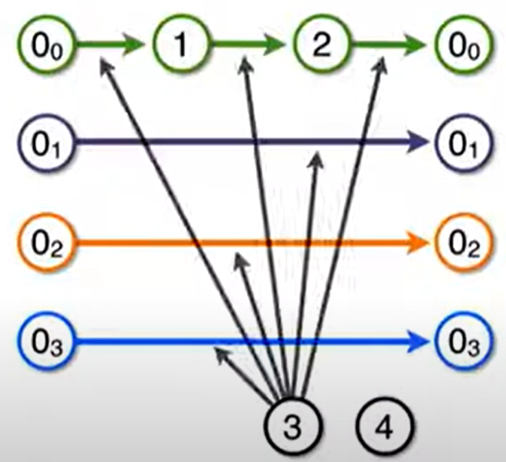
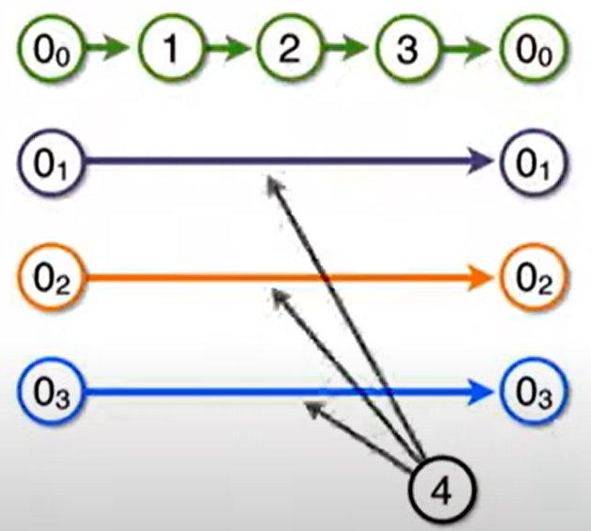
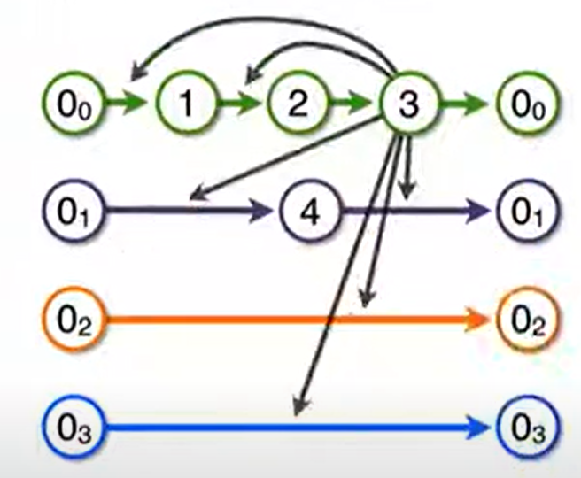
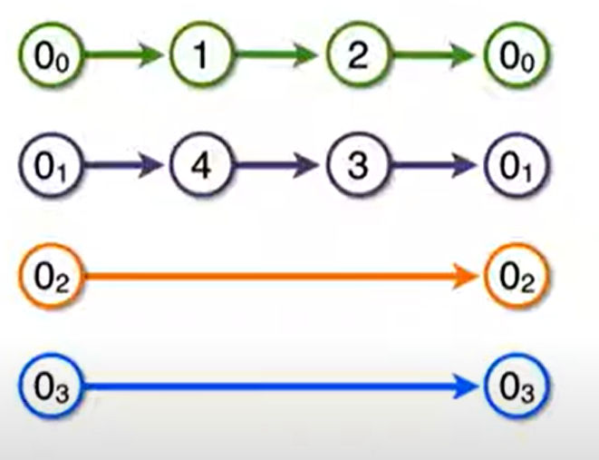
VRP – Local Search
Customer 1
Customer 2
Customer 3
Customer 4
Relocate customer 3
Final results

Slide 11
Reinforcement Learning VRP Environment
State (s) : At any time t, the state of every material(whether it is packed or not), and the state of every vehicle(which material is packed in it).
Action (a) : All the possible vehicles available for the next material.
Reward (r) : Total cost of the fitment. We need to minimize our reward, unlike standard RL problems. We define reward = ∑ (cost of each filled truck).
Episode (τ): One episode is defined as a full sequence of “M” materials to be packed.
Policy Network (π) : A stochastic policy that outputs the possibility of an action for every time step t.
Parameters (θ) : θ is a set of parameters that define the policy.

Slide 12
Study Reference
“Reinforcement Learning for Solving the Vehicle Routing Problem”
Published in 2018
Mohammadreza Nazari at el.

Slide 13
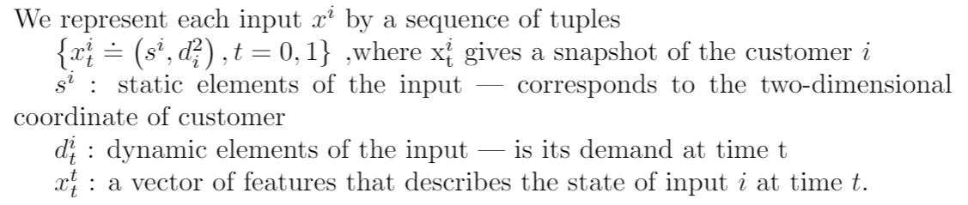
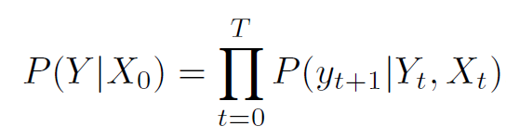
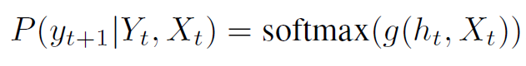
Model Architecture

Slide 14
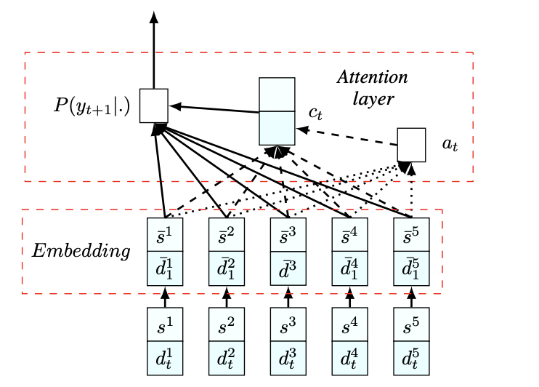
Model Architecture
Where:
s: customer
d(t): visited\not visited at time t
a(t): specifies how much every input data point might be relevant in the next decoding step t.
c(t): context vector

Slide 15
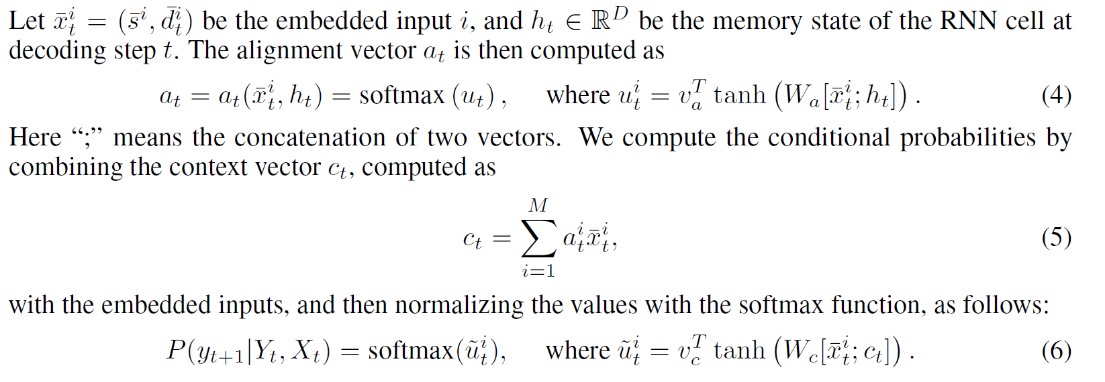
Attention Mechanism

Slide 16
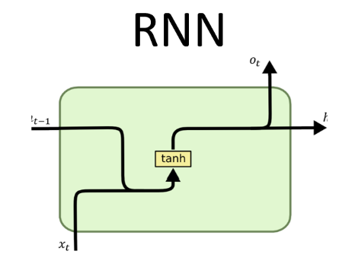
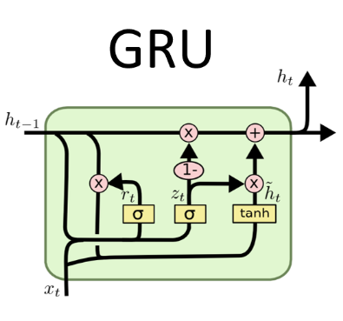
Our study

Slide 17
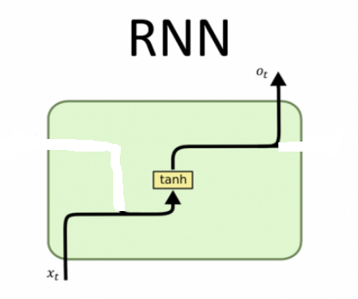
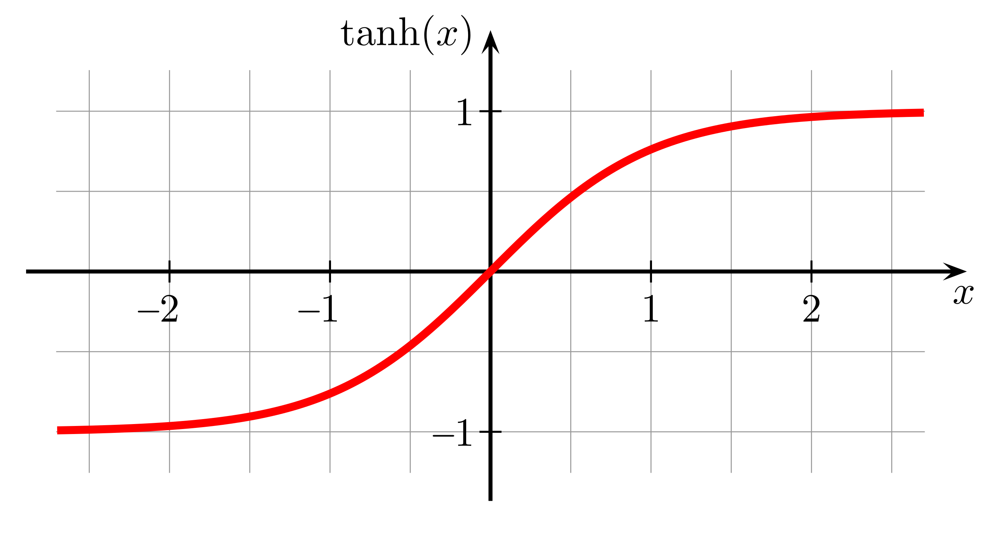
RNN
Similar to a neural network with a tan function. Results between [-1,1]

Slide 18
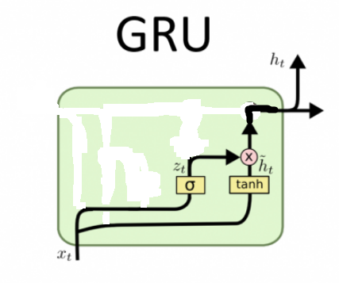
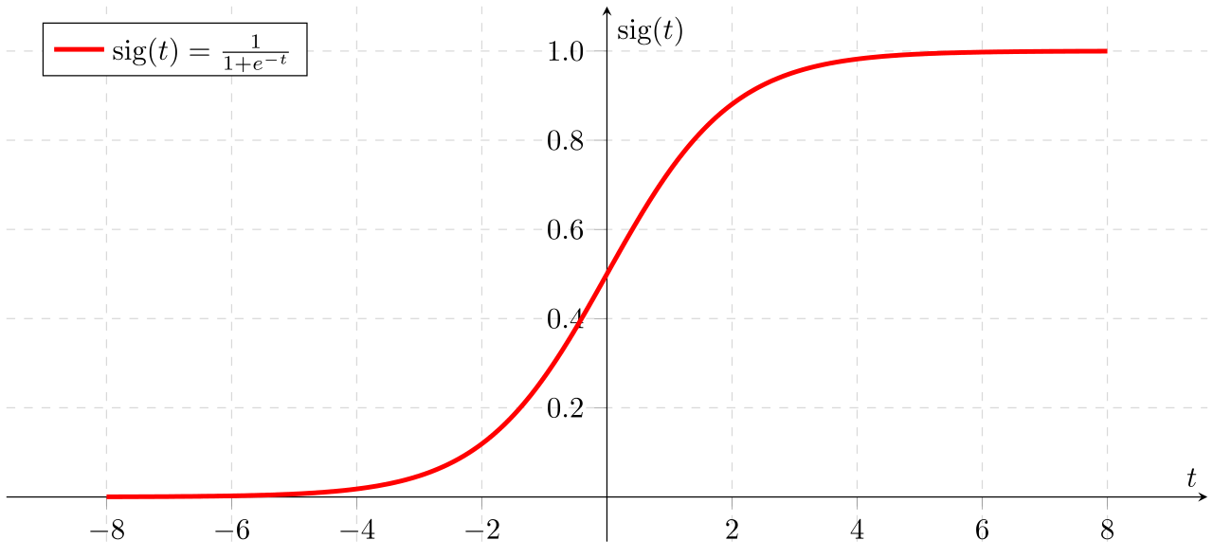
GRU
Similar to multiplying to output from two neural networks:
With tan activation function. Results between [-1,1]
With tan activation function. Results between [0,1]

Slide 19
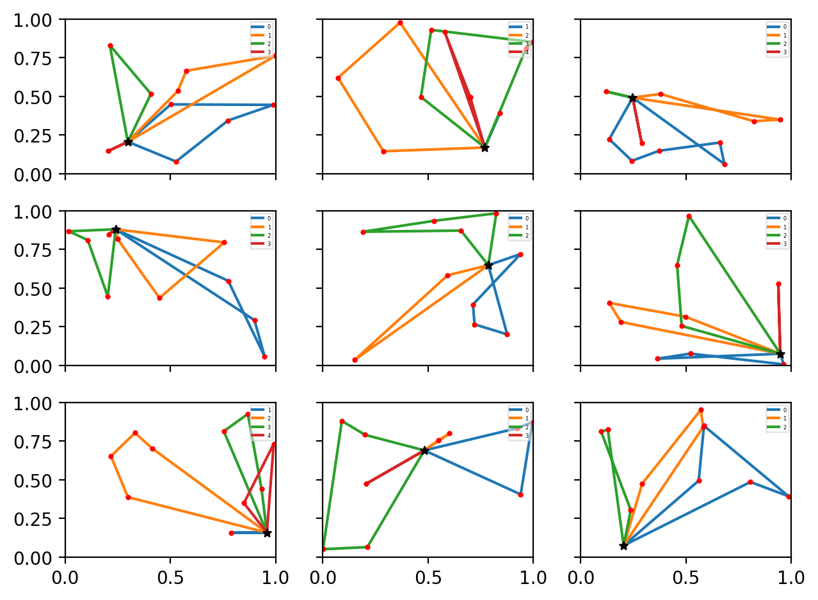
Experiments Results
VRP with 10 cities + load 20
Results
Paper(RNN) | Our(GRU)
3.97 | 4.01

Slide 20
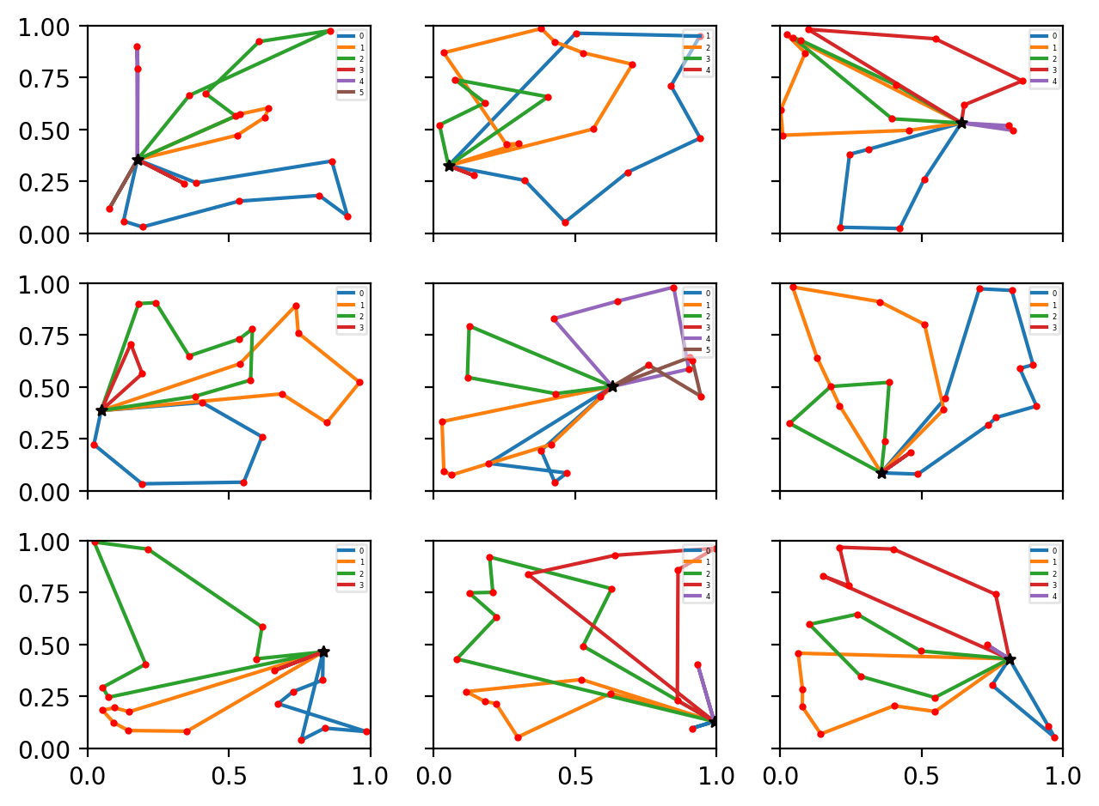
Experiments Results
VRP with 20 cities + load 30
Results
Paper(RNN) | Our(GRU)
6.59 | 6.91

Slide 21
THANKS!
ANY QUESTIONS?

